Slide 1
UPPER SIXTH ARTS
GEOGRAPHY
Practical Work 4
Calculating and Illustrating Transport Costs
Notes:
Good morning, class, and welcome to our geography lesson. I am your geography teacher, Mr Kamdem. Today we are starting Practical Work 4: Calculating and Illustrating Transport Costs.

Slide 2
CLASS INFO
Class, Chapter and Duration
Class | Upper Sixth Arts
Chapter | Module 6: Understanding and managing the dynamics of economic activities across the world in general and Cameroon in particular
Duration | 2 periods (2 × 50 minutes)
Notes:
This lesson is for Upper Sixth Arts. It belongs to Module 6: Understanding and managing the dynamics of economic activities across the world in general and Cameroon in particular. We shall need 2 periods to cover it.

Slide 3
IDENTIFICATION
Lesson Identification
Topic | Transport Activities and Characteristics
Sub-topic | Transport Costs Structures
Lesson | Practical Work 4: Calculating and Illustrating Transport Costs
Notions / Concepts | Terminal cost, line-haul cost, total cost, tapering, freight rate, break-of-bulk.
Syllabus focus | Types of transport costs; relative cost structure of modes; distance and cost relationships; transport cost and the nature of the commodity.
Competence | Learners are able to calculate transport costs and draw cost-distance graphs.
Notes:
Our topic is Transport Activities and Characteristics, and the sub-topic is Transport Costs Structures. The key notions we shall use today are: terminal cost, line-haul cost, total cost, tapering, freight rate, break-of-bulk. At the end, you should be able to do this: learners are able to calculate transport costs and draw cost-distance graphs.

Slide 4

HOMEWORK CORRECTION
Correction of the Homework
Question (Lesson 27: Transport):
Choose the best mode to carry cattle from Ngaoundéré to Yaoundé and justify your choice.
Notes:
Before we start the new lesson, let us correct the homework I gave you at the end of Lesson 27: Transport. The question was: Choose the best mode to carry cattle from Ngaoundéré to Yaoundé and justify your choice. Take out your exercise books.

Slide 5
HOMEWORK CORRECTION
Correction: Possible Answer
Rail (Camrail from Ngaoundéré) is best: it carries many cattle cheaply over a long distance and avoids bad roads. Road trucks are faster and door to door but costlier; trekking on foot is cheap but the cattle lose weight.
Notes:
Here is a good answer. Rail (Camrail from Ngaoundéré) is best: it carries many cattle cheaply over a long distance and avoids bad roads. Road trucks are faster and door to door but costlier; trekking on foot is cheap but the cattle lose weight. Compare it with your own answer and correct your work in red.

Slide 6
LESSON PLAN
Lesson Plan
Correction of the homework
Objectives and recall
Real-life situation and action to take
Learning activities
Board summary
Evaluation, remediation and homework
Notes:
Here is the plan of our lesson today. First, we shall correct the homework. Then we shall look at the objectives and recall what you already know. After that, we shall study a situation from real life and the action to take, and do the learning activities. Finally, we shall copy the board summary, do the evaluation and the remediation, and I will give you the homework.

Slide 7
OBJECTIVES
Objectives
By the end of this lesson, you should be able to:
Distinguish terminal and line-haul costs.
Calculate total transport cost for different modes.
Draw and interpret cost-distance graphs.
Notes:
By the end of this lesson, you should be able to do three things. Number 1: distinguish terminal and line-haul costs. Number 2: calculate total transport cost for different modes. Number 3: draw and interpret cost-distance graphs.

Slide 8
PREVIOUS KNOWLEDGE
Previous Knowledge
Road, rail and water are modes of transport.
A line graph shows how one value changes with another.
Notes:
Let us first remember what you already know. Road, rail and water are modes of transport. A line graph shows how one value changes with another. Keep this in mind, because we shall build on it today.

Slide 9
REAL-LIFE SITUATION
Situation in Real Life
A company in Garoua must send cement 300 km. The truck company, the railway and a river boat each give a price list. The class must find the cheapest mode.
Notes:
Listen carefully to this situation from real life. A company in Garoua must send cement 300 km. The truck company, the railway and a river boat each give a price list. The class must find the cheapest mode. Think about it, because I am going to ask you some questions.

Slide 10
REAL-LIFE SITUATION
Situation: Question 1
What is the problem in the situation?
Notes:
Question 1: What is the problem in the situation? Think for a moment, then raise your hand to answer.

Slide 11
REAL-LIFE SITUATION
Answer
The class must compare transport costs.
Notes:
Good. The class must compare transport costs.

Slide 12
REAL-LIFE SITUATION
Situation: Question 2
Which two costs make up the total?
Notes:
Question 2: Which two costs make up the total? Think for a moment, then raise your hand to answer.

Slide 13
REAL-LIFE SITUATION
Answer
Terminal cost and line-haul (distance) cost.
Notes:
Good. Terminal cost and line-haul (distance) cost.

Slide 14
REAL-LIFE SITUATION
Situation: Question 3
Which mode is best for very long distances?
Notes:
Question 3: Which mode is best for very long distances? Think for a moment, then raise your hand to answer.

Slide 15
REAL-LIFE SITUATION
Possible Answer
Usually water transport.
Notes:
Good. Usually water transport.

Slide 16
ACTION TO TAKE
Action to Take
Calculate transport costs before choosing a mode of transport.
Notes:
From this situation, the action we are working towards in this lesson is the following: calculate transport costs before choosing a mode of transport.

Slide 17
JUSTIFICATION
Justification of the Lesson
This practical work helps us to calculate and compare transport costs.
Notes:
Why is this lesson important for you? This practical work helps us to calculate and compare transport costs.

Slide 18

1. TYPES OF TRANSPORT COSTS
Activity 1
Cost-distance lines of three modes.
Notes:
Activity 1. Look carefully at this diagram: cost-distance lines of three modes. Observe every detail before I ask the question.

Slide 19
1. TYPES OF TRANSPORT COSTS
Activity 1: Question
What is a terminal cost?
Notes:
Here is the question for Activity 1: What is a terminal cost? Take one minute to think and write your answer in your rough notebook.

Slide 20
1. TYPES OF TRANSPORT COSTS
Activity 1: Answer
The fixed cost of loading, unloading and handling, paid whatever the distance.
Notes:
Let us check the answer together. The fixed cost of loading, unloading and handling, paid whatever the distance.

Slide 21
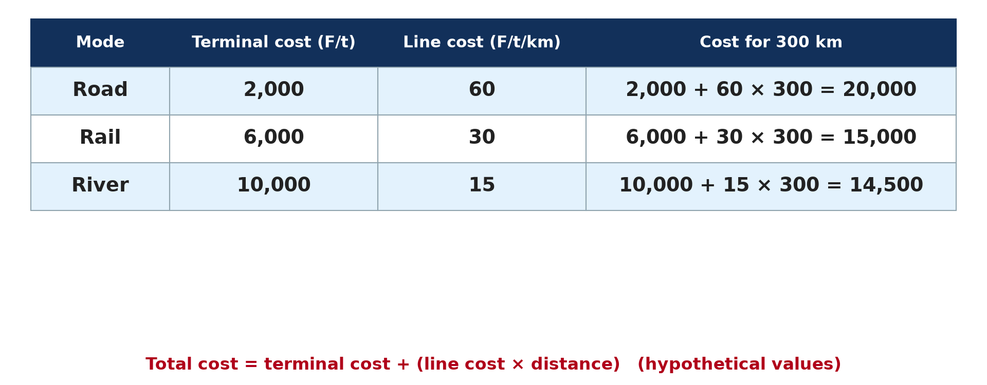
2. CALCULATING TRANSPORT COSTS
Activity 2
Worked example (hypothetical values).
Notes:
Activity 2. Look carefully at this diagram: worked example (hypothetical values). Observe every detail before I ask the question.

Slide 22
2. CALCULATING TRANSPORT COSTS
Activity 2: Question
Calculate the road cost for 300 km.
Notes:
Here is the question for Activity 2: Calculate the road cost for 300 km. Take one minute to think and write your answer in your rough notebook.

Slide 23
2. CALCULATING TRANSPORT COSTS
Activity 2: Answer
2,000 + (60 × 300) = 20,000 F per tonne.
Notes:
Let us check the answer together. 2,000 + (60 × 300) = 20,000 F per tonne.

Slide 24
2. RELATIVE COST STRUCTURES
Activity 3
Where each line is lowest.
Notes:
Activity 3. Look carefully at this diagram: where each line is lowest. Observe every detail before I ask the question.

Slide 25
2. RELATIVE COST STRUCTURES
Activity 3: Question
Why is road cheapest for short distances?
Notes:
Here is the question for Activity 3: Why is road cheapest for short distances? Take one minute to think and write your answer in your rough notebook.

Slide 26
2. RELATIVE COST STRUCTURES
Activity 3: Answer
It has the lowest terminal cost.
Notes:
Let us check the answer together. It has the lowest terminal cost.

Slide 27
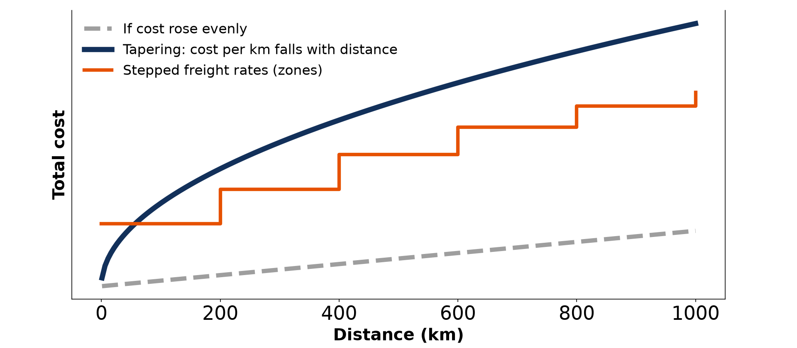
3. DISTANCE AND COST
Activity 4
Tapering freight rates.
Notes:
Activity 4. Look carefully at this diagram: tapering freight rates. Observe every detail before I ask the question.

Slide 28
3. DISTANCE AND COST
Activity 4: Question
What does "tapering" mean?
Notes:
Here is the question for Activity 4: What does "tapering" mean? Take one minute to think and write your answer in your rough notebook.

Slide 29
3. DISTANCE AND COST
Activity 4: Answer
The cost per kilometre falls as the distance increases.
Notes:
Let us check the answer together. The cost per kilometre falls as the distance increases.

Slide 30

4. COST AND COMMODITY
Activity 5
A logging truck.
Notes:
Activity 5. Look carefully at this picture: a logging truck. Observe every detail before I ask the question.

Slide 31
4. COST AND COMMODITY
Activity 5: Question
Why do bulky or perishable goods cost more to carry?
Notes:
Here is the question for Activity 5: Why do bulky or perishable goods cost more to carry? Take one minute to think and write your answer in your rough notebook.

Slide 32
4. COST AND COMMODITY
Activity 5: Answer
Bulky goods need more space and perishable goods need speed or cooling.
Notes:
Let us check the answer together. Bulky goods need more space and perishable goods need speed or cooling.

Slide 33
BOARD SUMMARY
Board Summary
Topic: Transport Activities and Characteristics
Sub-topic: Transport Costs Structures
Practical Work 4: Calculating and Illustrating Transport Costs
Notes:
Now we are going to copy the board summary. Write the title and the headings neatly in your notebooks. I will give you enough time for each slide, so do not rush.

Slide 34
BOARD SUMMARY
1. Types of Transport Costs
Transport costs are of the following types:
Terminal cost: It is the fixed cost of loading, unloading, handling and storing goods at the terminals. It is paid whatever the distance travelled.
Notes:
Let us copy Types of Transport Costs. Transport costs are of the following types. On this slide we have Terminal cost. Write each point on a new line, with the key term first, and explain it in your own words when we revise. When you finish, we go to the next slide.

Slide 35
BOARD SUMMARY
1. Types of Transport Costs (continued)
Line-haul cost: It is the cost of moving goods along the route, such as fuel, wages and wear of vehicles. It rises with distance.
Total cost: It is the sum of the terminal cost and the line-haul cost. Total cost = terminal cost + (line cost × distance).
Notes:
We continue with Types of Transport Costs. On this slide we have Line-haul cost and Total cost. Write each point on a new line, with the key term first, and explain it in your own words when we revise.

Slide 36
BOARD SUMMARY
2. Relative Cost Structure of the Modes
The cost structure of each mode is calculated and drawn as follows:
Calculation: Apply the formula to each mode for each distance. For example, road: 2,000 + (60 × 300) = 20,000 F per tonne for 300 km.
Notes:
Let us copy Relative Cost Structure of the Modes. The cost structure of each mode is calculated and drawn as follows. On this slide we have Calculation. Write each point on a new line, with the key term first, and explain it in your own words when we revise. When you finish, we go to the next slide.

Slide 37
BOARD SUMMARY
2. Relative Cost Structure of the Modes (continued)
Graph: Plot distance on the x-axis and cost on the y-axis, then draw one line per mode. The crossing points show where the cheapest mode changes.
Notes:
We continue with Relative Cost Structure of the Modes. On this slide we have Graph. Write each point on a new line, with the key term first, and explain it in your own words when we revise. When you finish, we go to the next slide.

Slide 38
BOARD SUMMARY
2. Relative Cost Structure of the Modes (continued)
Relative costs: Road has low terminal costs but high line costs, so it is cheapest for short trips. Rail is cheapest for medium distances, and water, with high terminal but very low line costs, for long distances.
Notes:
We continue with Relative Cost Structure of the Modes. On this slide we have Relative costs. Write each point on a new line, with the key term first, and explain it in your own words when we revise.

Slide 39
BOARD SUMMARY
2. Relative Cost Structure of the Modes
Illustration: cost-distance lines of three modes
Notes:
Now draw this illustration in your notebook: cost-distance lines of three modes. Give it a title and label it clearly.

Slide 40
BOARD SUMMARY
3. Distance and Cost Relationships
Cost and distance are related as follows:
Tapering: The cost per kilometre falls as distance increases because the terminal cost is shared over more kilometres. The total cost still rises, but more slowly.
Notes:
Let us copy Distance and Cost Relationships. Cost and distance are related as follows. On this slide we have Tapering. Write each point on a new line, with the key term first, and explain it in your own words when we revise. When you finish, we go to the next slide.

Slide 41
BOARD SUMMARY
3. Distance and Cost Relationships (continued)
Stepped freight rates: Carriers often charge the same rate within distance zones. The cost then rises in steps rather than in a straight line.
Notes:
We continue with Distance and Cost Relationships. On this slide we have Stepped freight rates. Write each point on a new line, with the key term first, and explain it in your own words when we revise.

Slide 42
BOARD SUMMARY
3. Distance and Cost Relationships
Illustration: tapering freight rates
Notes:
Now draw this illustration in your notebook: tapering freight rates. Give it a title and label it clearly.

Slide 43
BOARD SUMMARY
4. Transport Cost and Commodity
The nature of goods and movement affects costs as follows:
Nature of goods: Bulky, fragile, perishable or dangerous goods cost more to carry. Light and valuable goods can pay for fast air transport.
Notes:
Let us copy Transport Cost and Commodity. The nature of goods and movement affects costs as follows. On this slide we have Nature of goods. Write each point on a new line, with the key term first, and explain it in your own words when we revise. When you finish, we go to the next slide.

Slide 44
BOARD SUMMARY
4. Transport Cost and Commodity (continued)
Break-of-bulk: Changing from one mode to another adds terminal costs. Industries often locate at these break-of-bulk points, such as ports.
Notes:
We continue with Transport Cost and Commodity. On this slide we have Break-of-bulk. Write each point on a new line, with the key term first, and explain it in your own words when we revise.

Slide 45
FORMATIVE EVALUATION
Evaluation 1
Rail: terminal 6,000 F, line 30 F/km. Find the cost for 500 km.
Notes:
Now let us check what you have understood. Question 1: Rail: terminal 6,000 F, line 30 F/km. Find the cost for 500 km. Answer in your exercise book.

Slide 46
FORMATIVE EVALUATION
Expected Answer
6,000 + (30 × 500) = 21,000 F.
Notes:
The expected answer is: 6,000 + (30 × 500) = 21,000 F. If you got it right, well done.

Slide 47
FORMATIVE EVALUATION
Evaluation 2
Why is water transport cheapest over long distances?
Notes:
Now let us check what you have understood. Question 2: Why is water transport cheapest over long distances? Answer in your exercise book.

Slide 48
FORMATIVE EVALUATION
Expected Answer
Its line cost is very low, so its high terminal cost is shared over many kilometres.
Notes:
The expected answer is: its line cost is very low, so its high terminal cost is shared over many kilometres. If you got it right, well done.

Slide 49
REMEDIATION
Remediation
Fill in the blanks:
Loading and unloading make the ______ cost.
The fall in cost per km with distance is ______.
Notes:
Take your time to copy this part; we will continue together.

Slide 50
REMEDIATION
Remediation (continued)
The cheapest mode for short distances is ______.
Notes:
For those who need more practice, fill in the blanks in your exercise book. The answers are: number 1, terminal; number 2, tapering; number 3, road.

Slide 51
HOMEWORK
Homework
Draw the cost-distance graph for road, rail and river using the table, up to 600 km.
Notes:
For your homework: Draw the cost-distance graph for road, rail and river using the table, up to 600 km. We shall correct it at the beginning of our next lesson.

Slide 52
NEXT LESSON
Next Lesson
Our next lesson will be on:
Lesson 28: Transport Networks
Notes:
Our next lesson will be on Lesson 28: Transport Networks. Thank you for your attention, and see you next time.

Slide 53
BILINGUAL GAME
Bilingual Game (Jeu Bilingue)
English | Français
Cost | Le coût
Distance | La distance
Freight | Le fret
Loading | Le chargement
Graph | Le graphique
Perishable | Périssable
Notes:
Let us play the bilingual game. I say a word in English, and you give me the French word. Then we do the reverse.

Slide 54
LOGBOOK
Official Logbook (1/2)
Module / Topic | Transport Activities and Characteristics
Lesson Title | Practical Work 4: Calculating and Illustrating Transport Costs
Expected Learning Outcomes | Distinguish terminal and line-haul costs. Calculate total transport cost for different modes. Draw and interpret cost-distance graphs.
Competence | Learners are able to calculate transport costs and draw cost-distance graphs.
Notes:
I record this information in the official logbook of the class after the lesson.

Slide 55
LOGBOOK
Official Logbook (2/2)
Matter Taught | Types of Transport Costs; Relative Cost Structure of the Modes; Distance and Cost Relationships; Transport Cost and Commodity.
Evaluation | Formative evaluation and remediation exercise.
Homework | Draw the cost-distance graph for road, rail and river using the table, up to 600 km.
Enrolment / Present / Absent | ____ / ____ / ____
Achievement | To be completed after the lesson.
Notes:
I complete the second page of the logbook: the matter taught, the evaluation, the homework and the attendance.

Slide 56
TEACHER'S NOTE
Teacher's Note
Timing: Homework correction, plan, objectives 8 min | Recall, situation, action 10 min | 5 activities 30 min | Board summary (copying) 30 min | Evaluation, remediation 10 min | Homework, next lesson 5 min | Logbook 7 min
Without the projector (Activity 1): list terminal costs.
Without the projector (Activity 2): calculate each mode.
Without the projector (Activity 3): find the crossing points.
Without the projector (Activity 4): explain tapering.
Without the projector (Activity 5): compare logs and flowers.
Notes:
This slide is for me, the teacher: it gives the timing of the lesson and what to do if the projector is not available.

Slide 57
REFERENCES
References
National Geography Syllabus, MINESEC/IGE/IP-SS, 2019 — Module 6 (Economic Geography).
Photo, Activity 5: “Logging truck, Cameroon” by World Resources, CC BY-NC-SA 2.0, via Flickr (https://www.flickr.com/photos/26107309@N05/4764354366)
Diagrams and animations: drawn for this lesson (Geography Department).
Notes:
These are the references and picture credits used to prepare this lesson.

